Slide 1

One
ata

Slide 2
Goals
Define a common strategic vision around data and conceive a unified Data Offer
Define a common strategic vision around AI
Design a group M0 / M1 for Data / AI
Share the most relevant Rex Data / AI that can be used

Slide 3
Plan
10h - 11h : presentation of what exists at Devoteam around Data
11h - 12h : Data M0 workshop
12h - 13h 30 : Lunch and restitution
14h - 15h : presentation of what exists at Devoteam around AI
15h - 16h : AI M0 workshop
16h -17 h : Rex and next Steps

Slide 4

the One Data pyramid.
Data Gouvernance
AI
Analytics
Viz
Smart Data
Data Protection
Data Access
Data
Foundation
Big Data Ecosystem
and Data Pipes
Cloud | Hybrid | On premise

Slide 5




















data governance
one
ata
data strategy
data management
data quality/excellence
140+ consultants
250+ consultants
35+ data managers 15+ data quality
15+ data protection
#data strategy #gouvernance #marketing & change #CDO
data foundation
smart data
data for business
#design #platform & solutions #data modeling #data flows #cloud ecosystem #datalab #agile #devops
#DaaS #ML/AI
#dataviz #data science #data UX #data experiment #data apps #data monetize (time to value) #predictive data #autonomous intel
AI/ML
data compliance & security
data ecosystem architecture
data modeling & flows
agile & devops for data
data science
data viz
Autonomous intelligence
85+ engineers 35+ architects
120+ certifications
70+ data scientists 40+ expert solutions
60+ biz/data analysts
#Cybersecurity #DPIA #DPO

Slide 6


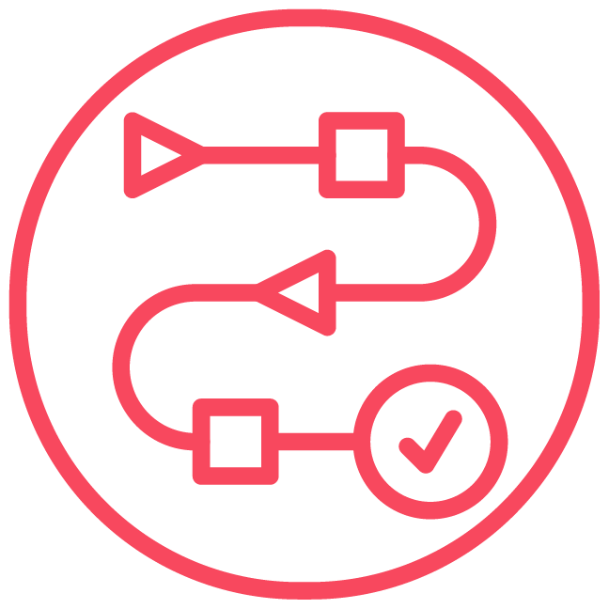
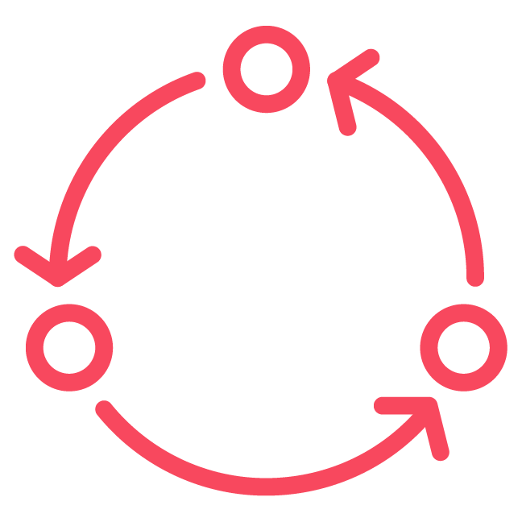




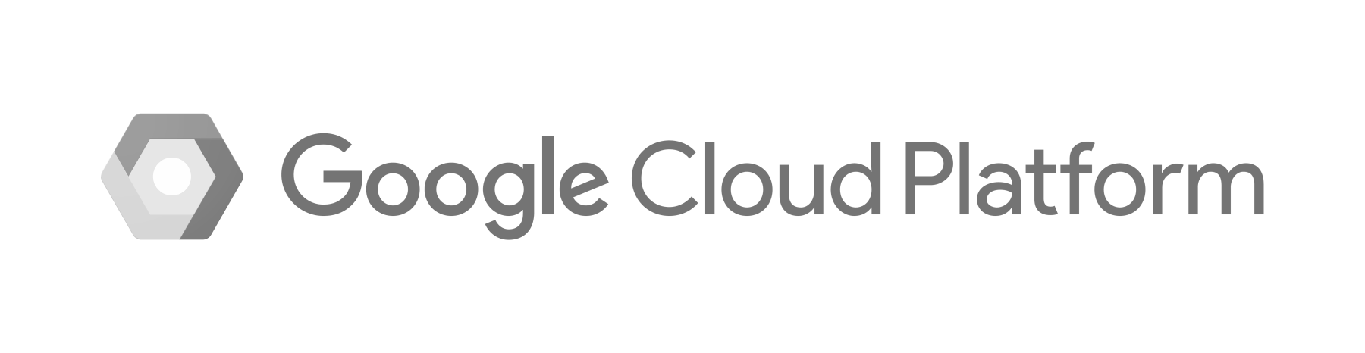

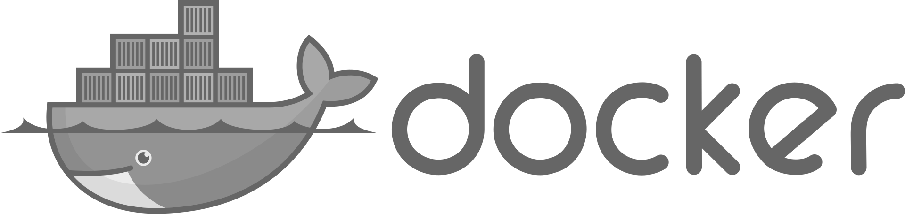




“ New paradigms of architecture and operations lead to the implementation of new Data foundations ”
one
ata
foundation
CoE ready
A new real data landscape
New IT practices
+
85+ engineers 35+ architects
120+ certifications
A new approach required to deploy and operate a service oriented 'data infrastructure" to optimize and make efficient use and access to data to meet business needs
Data ecosystem architecture
Define the ecosystem that meets service objectives and aligns with the company's data strategy.
An Agile & DevOps methodology
... to deploy agile and robust architectures (devops, microservices...) to meet the operational and decisional challenges of our clients
Data modeling & data flow
Set up and share a common data model within the organization.
Security by design
… with fundamentals based on a culture of compliance and its challenges "Compliance & Security by design"
Agile & Devops for Data
Implement, develop and promote new technologies and practices that ensure effective collaboration and improve time to value.
SCALABILITY / SECURITY / REAL TIME / AUTOMATION
Notes:
46+ engineers 12+ architects
40+ certifications

Slide 7



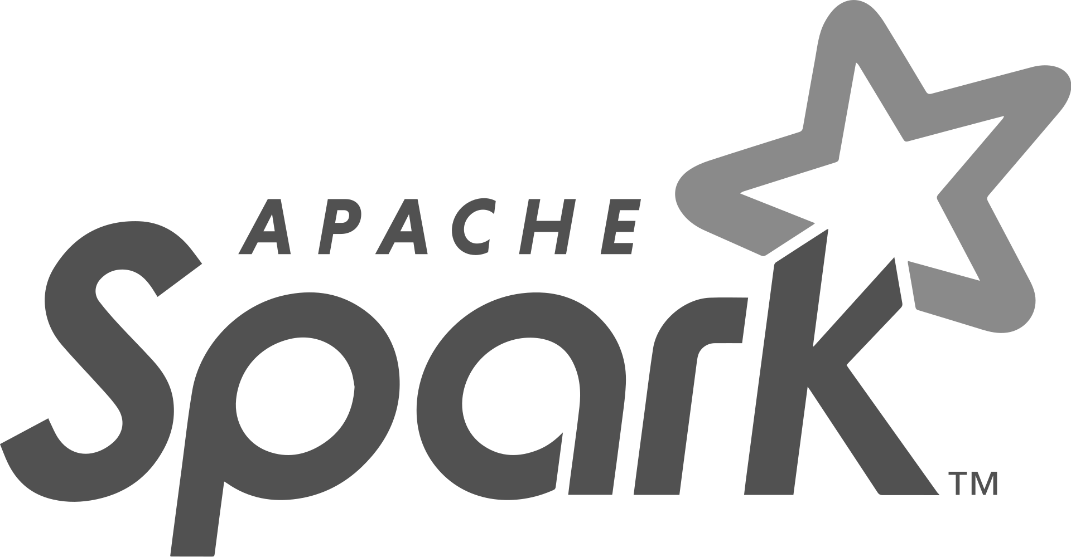









“ Data is a strategic asset to succeed the digital challenges of the company ”
one
ata
for business
CoE ready
A new Intelligence
New operational and business models
+
70+ data scientists 40+ expert solutions
60+ biz/data analysts
New services to make fast and reliable decisions, create new revenue streams, innovative new products and services, and optimize operational efficiency
Data Science
Explore / exploit data and turning it into insights to identify trends with an industrialization approach to Data Science models.
Smarter and faster businesses
… with data widely used and integrated into the business strategy, tactical and operational decisions of the company
Data Viz / Modern BI
Design and communicate relevant dashboards in support of performance management and operational efficiency of the company.
Monetize data to meet business needs : time to value
... by capturing instantaneous information from real-time data, rich exploration of historical data and triggering decisions and actions driven by the data
Autonomous Intelligence
Design tools / approaches to augment the work of experts and automate / facilitate decision-making.
TIME TO VALUE / INTELLIGENCE / DECISION MAKING

Slide 8


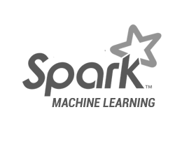

“ Offer smart data to applications with turnkey services ”
one
ata
smart
CoE ready
Open smart data to applications
Ensure the efficiency of models over time
+
45+ engineers 20+ architects
70+ scientists
An ML & AI models approach to quickly and repeatedly provide information and benefits from data coupled with application-consumable services
Data as a Service
Provide smart data access services. Rely on a microservices architecture offering horizontal scalability and secured via API management solutions.
Manage models and services
101011
00011
110110
… Deploy, secure and evolve them : improve ML & IA models, expose smart data access services
AI ^{AI}
AI/ML
Provide APIs based on ML models developed
Customize the models, validate their efficiency and keep them in production : model serving
Provide vertical turnkey "APIzed" services while taking advantage from those provided by cloud players
… Consider the different fields of application of the AI
Industrialize the processes for AI
Propose and develop models and APIs for most use cases
µSERVICES / SCALABILITY / API MANAGEMENT / ML & IA MODELS
Notes:
A discuter le jour du workshop :

Slide 9


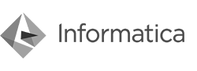

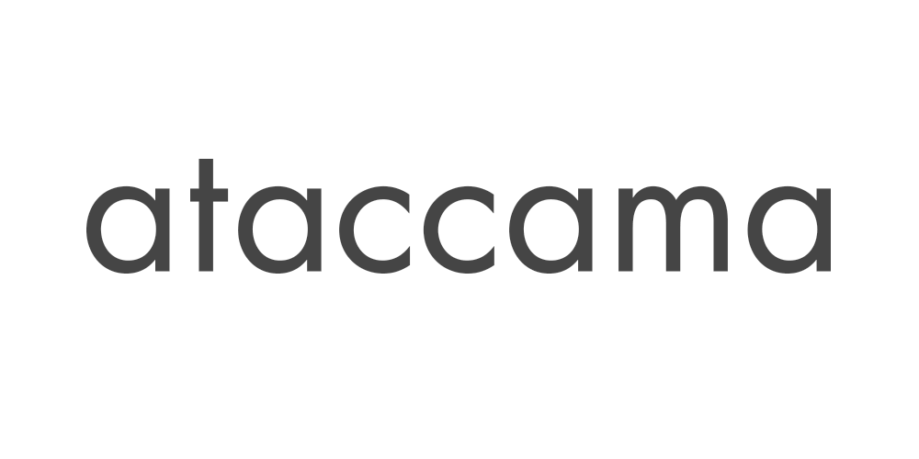



“ Build data capacities and organizations to unlock business value and avoid data leaks ”
one
ata
governance
CDO external
Exponential data volumes
Sensitive data
+
35+ data managers 15+ data quality
15+ data protection
An approach to ensure compliance and data security from conception and throughout its life cycle
Data Strategy
Organize, govern and protect data across the enterprise, according to the company's strategy and regulations.
A major asset of the company
1011
001
Controlled data with company-wide shared fundamentals can improve all business processes
Data Management
Define and consistently manage critical business data to provide a single point of reference.
A unique methodology developed
… based on data quality techniques, solid experience in data management and a pragmatic mindset
1011
001
Data Quality/Excellence
Provide an improved methodology to optimize business processes and increase the value of data.
CONFORMITY / SECURITY / BUSINESS VALUE
Notes:
François benjamin / danemark
Ajouter un slide Data protection

Slide 10



























data governance
one
ata
data strategy
data management
data quality/excellence
_Strong and strategic_ ;partnerships ;
data foundation
smart data
data for business
IA/ML
data compliance & security
data ecosystem architecture
data modeling & flows
agile & devops for data
data science
data viz
Autonomous intelligence

Slide 11
One
ata
CoE
⁽
⁾
*
* Centre of Excellence

Slide 12






Stakes for
Stakes for
The client and its business lines
IT services
Be the Data reference partner for the entire Group
Guarantee to business lines the best price and the benefits from scale effects
Positioning on functional areas to create value
Have a capacity for innovation allowing businesses to differentiate themselves
Offer tailor-made or packaged on demand offers in line with the needs of business lines
For business lines and support functions : taking advantage of innovative services and products
Allow augmented business experience
Optimize the costs of using services
Support the client's development strategy
one
ata
CoE
“ Meet the data challenges of our clients and create value and services for their businesses ”

Slide 13




The benefits of the partnership
The founding principles
Organization and common and effective governance
A DEVOTEAM responsibility on the services with clear client-side roles
Investment choices jointly made and on the basis of clear and shared criteria (proposals, new services ...)
A common approach to business lines (marketing, communication, prospecting)
Development of the use of the platform
Co-investment in business development with business lines
Reinforce adoption (comm, marketing)
Create value
Approach to digitize services
Showcase effect through the provision of innovative uses, technologies and practices
Innovation and training
Integrate solutions partners in innovation device (design thinking workshops, lab, ...)
Animate a Data community at Client scale
Access to DEVOTEAM training programs
Secure the customer relationship
Monitor performance and quality
Financial transparency
Variability and cost transparency
Adjust resources depending on the activity
Financial transparency
Flexibility and optimization of means and resources
Skilled resources at the right price level and adjustable depending on the activity to be carried out
Industrialization and continuous improvement
Projects delivery in agile mode
Optimize sourcing and productivity
one
ata
CoE
“ A partnership with the ambition of a voluntary development of value and a continuous optimization of the activities ”

Slide 14
Goals to reach
Distribution of roles
Accelerator team
DEVOTEAM commitments
Expand the BL clients portfolio on the client offer Data
Manage customer relationship and satisfaction
Evangelize via Success Stories and ongoing projects
Key activities
Define and setup a pre-sales approach equipped to address business lines in their business logic
Build and animate slidedeck, value propositions and a contact plan for each business line
Manage client service portfolio including pipeline, allowing a permanent control whether it is economic or qualitative
Animate a Client Club and measure satisfaction
Mobilize DEVOTEAM sales forces to
Facilitate linking and winning business
with specific incentives
Reinforcement by DEVOTEAM of a Business Developer for the launch of the CoE
Mobilize pre-sales forces to develop proposals and defences
Transparency on the live solicitations of the BLs and answers exclusively made within the process defined for the CoE
Target BLs and define a sales strategy per client type
Realize and follow up a Business Plan made jointly with the Client
Follow up indicators
Number of BL addressed
Number of created leads
Number of new projects
Sales force
Account Manager
Partner Solution expert
Business Analysts
Business Developper
one
ata
CoE
“ Data Accelerator : a commercial approach
- Business lines Centric - shared, piloted and tooled ”
_CLIENT_
business lines
_CLIENT_

Slide 15


one
ata
CoE
“ A CoE organization structured around 4 services offering ”
Data “Accelerator”
_CLIENT_
Co-building with business lines and opportunities development
Business Relationship Management
Customer success
Inspiration & Design
Projects & adoption
Data Factory
Finance, contract, sourcing
Strategy
Innovation & offer building
Architecture & design solution
Vendor (solutions partners) insights
Marketing & communication
PMO & PM in agile mode
Business analysis
Change management & adoption
Factory
Build team
Solution maintenance
Performance
Industrialization
Automation
Reporting
Production support
L3/4 support
Release Management
Contract management
Resource management
Management control
Governance
Functional governance
Data Community
Services Consulting
Business & innovative Services
Adoption Services
Data Factory Services
...
A shared services catalog

Slide 16
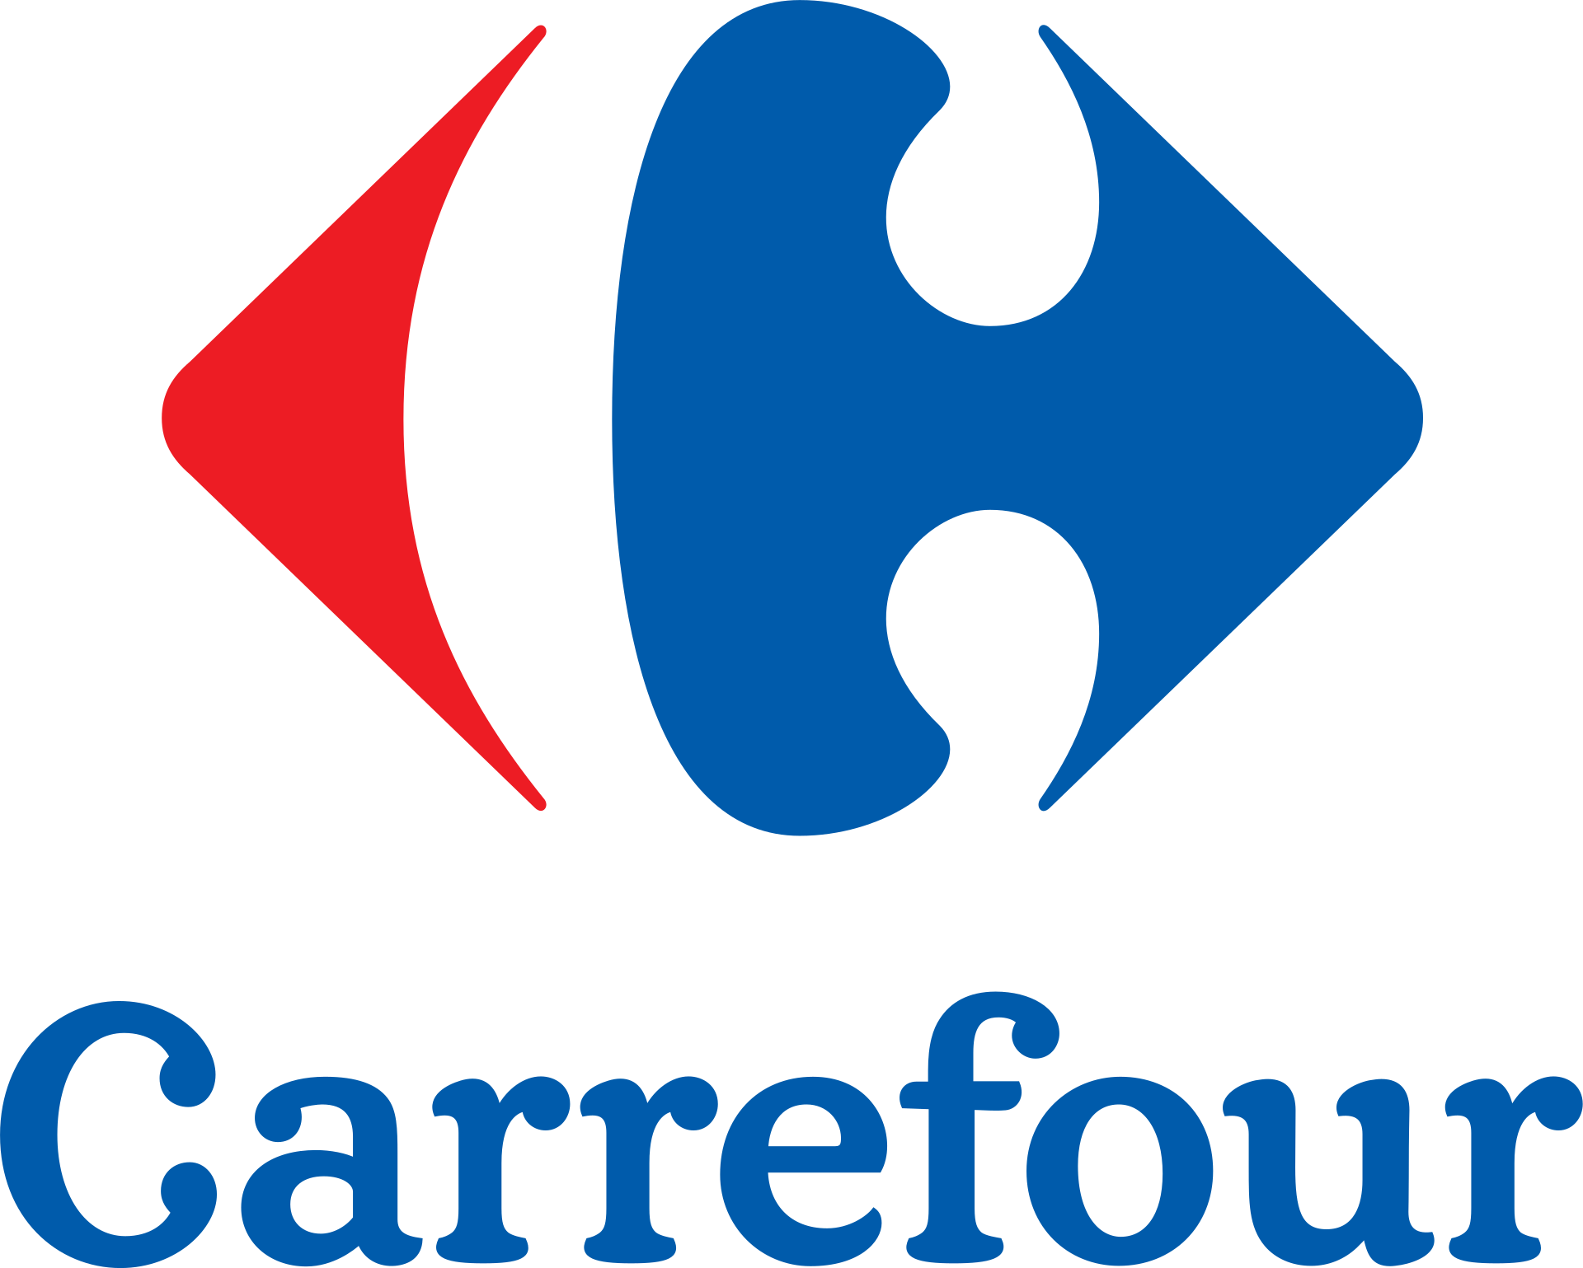






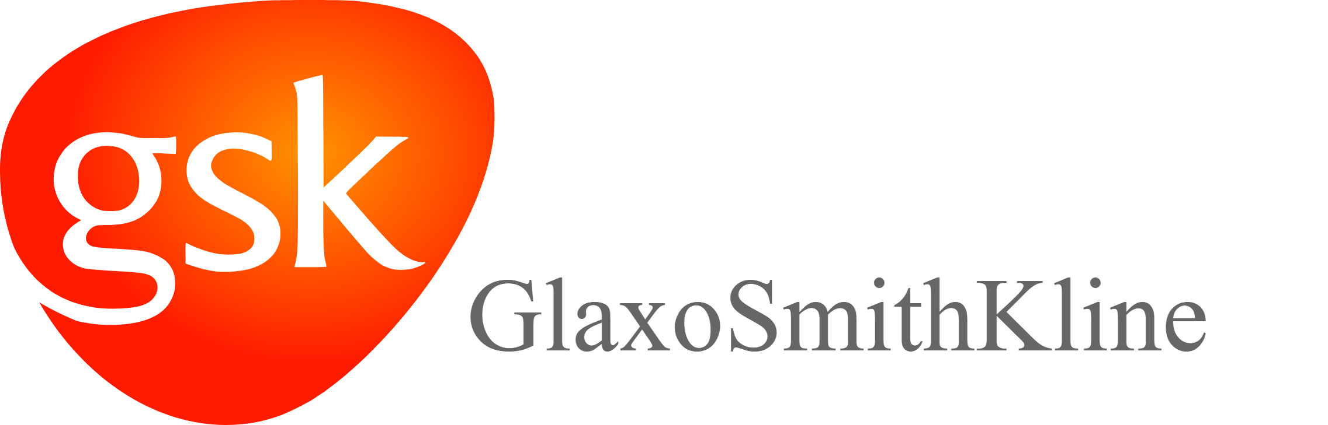





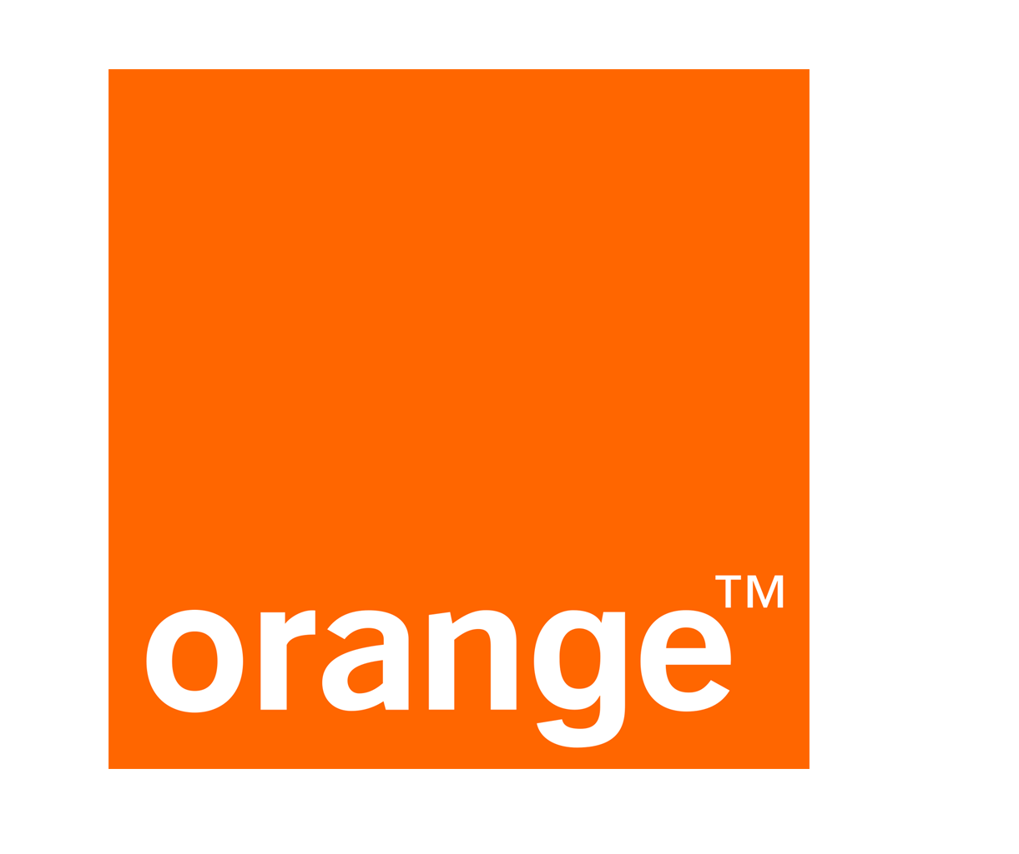



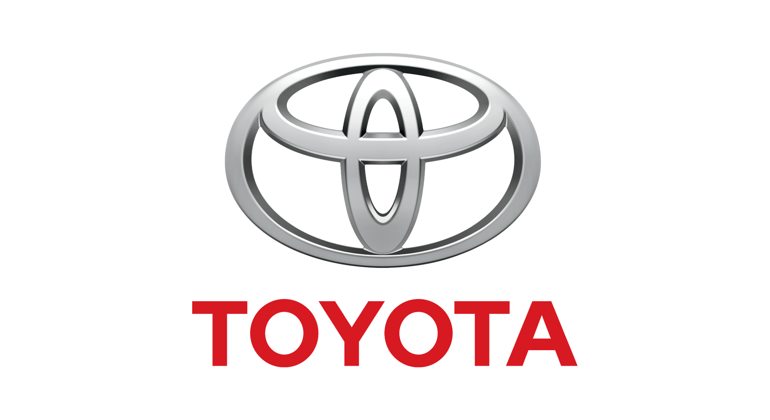



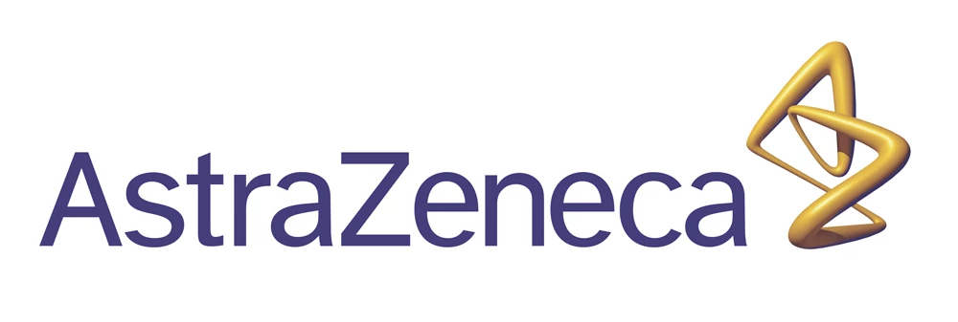








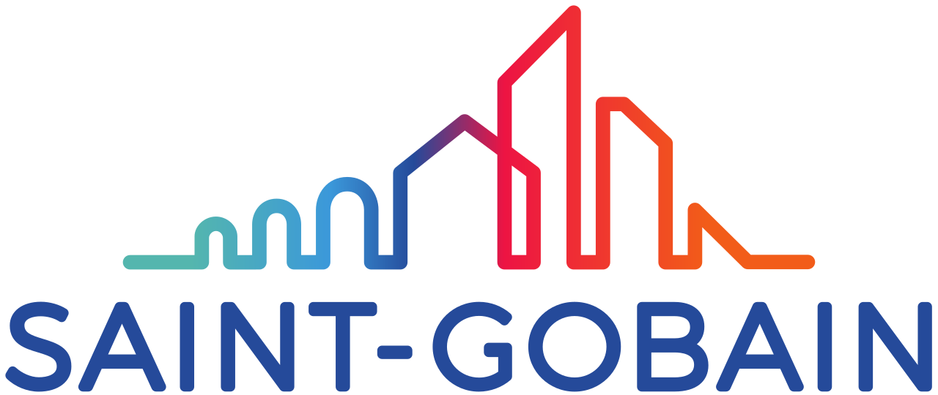

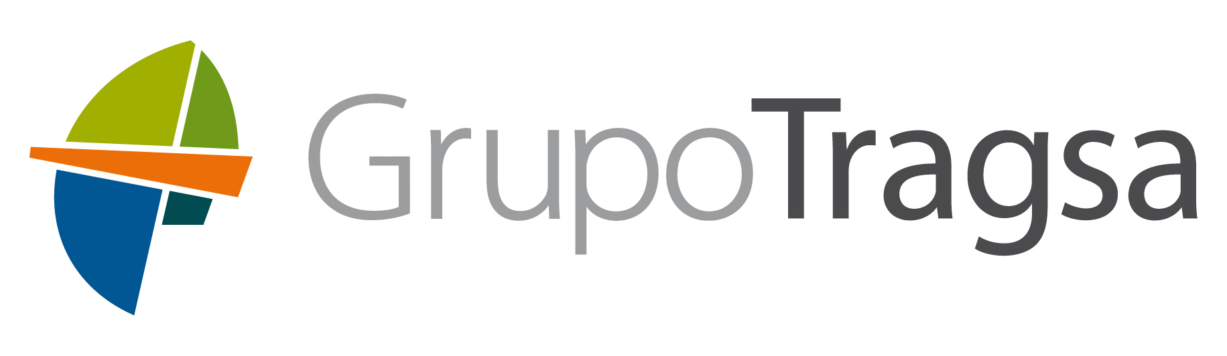





They trust us

Slide 17
AI is not only a new technological paradigme, it’s also a totally new territory for users
Design Cognitive Experiences that develop adoption & usages
Start building confidence in algorithms
Simple & intuitive
Anchored to the growing usages of BtC vocal assistants & bots
Tailored to Business specific needs
Permanently monitor & test potential improvements
Involve users from day one to select the use cases & key fonctions
Begin with well controlled actions, with high volume, where human do mechanical & repetitive tasks
Be transparent on what algorithms do
Notes:
Voir la validité de ce slide : faire evoluer ce slide :
Nos convictions
Problématiques,
Ce qu’on propose, : IA conseil, IA techno, IA indus, IA formation, un slide des techno
Un petit mail, forepass,
Un mail à Still technology,
Communauté IA, un espace de partages, Document, Préz Clients, Un Call Hangout , un point tous les 15 jours,

Slide 18
There is no AI without IA
81%
Do not
Understand the
Data required for
AI
80%
Of data is either
Inaccessible,
Untrusted or
unanalyzed
NO amount of AI algorithmic sophistication will overcome a lack of data [architecture]...bad data is simply paralyzing
Notes:
Data virtualization : Ab initio,
Partage de cockpit, partage de Mo, share drive AI: mettre les droits d’accès au fichier

Slide 19
AI challenges
Governance serves as an end-to-end foundation for all the other dimensions.
The core goal is to help organisations develop AI that is not only compliant with applicable regulations, but is also ethical.
Provides an approach and utilities for AI-driven decisions to be interpretable and easily explainable by those who operate them and those who are affected by them.
Helps organisations develop AI systems that provide robust performance and are safe to use by minimising the negative impact.
Addresses the issues of bias and fairness—it is possible for organisations to design AI systems to mitigate unwanted bias and achieve decisions that are fair under a specific and clearly communicated definition.
Responding to AI challenges across 5 key dimensions

Slide 20
AI reality check
Structure (Why): Organize for ROI and momentum
Workforce: Teach AI citizens and specialists to work together
Trust: Make AI responsible in all its dimensions
Data: Locate and label to teach the machines
Reinvention: Monetize AI through personalization and higher quality
Convergence: Combine AI with analytics, the IoT, and more
AI priorities
Notes:
Why dans la structure : structure is missliding, tirer l’Ia par une intension stratégique
What : Trust & Data & personnalize
How : workforce & convergence

Slide 21
Unstructured,Volatile,High-Volume
Effectiveness Model Support seamless integration and collaboration · Wide range of interconnected work activities · Highly reliant on coordination and communication Example solutions: virtual agents for consumers or for enterprises customer service;collaboration or workflow management | Innovation Model Enable creativity and ideation · original,innovation work · highly reliant on deep expertise,experimentation, exploration and creativity Example solutions: support for biomedical research ; fashion design ; music writing
Efficiency Model Provide consistent , low-cost performance · routine work with little discretion · highly reliant on well-defined and well-understood criteria ,rules and procedures Example solutions:automated credit decisions ;data verification | Expert Model Leverage specialized expertise · judgment-oriented work · highly reliant on expertise and experience Example solutions:expert system for medical diagnosis; legal or financial research
Augmentation
Data Complexity
Automation
Structured,Stable,Low-Volume
Routine ,Predictable,Rules-based
Ad Hoc,Unpredictable,Judgement-based
Work Complexity

Slide 22
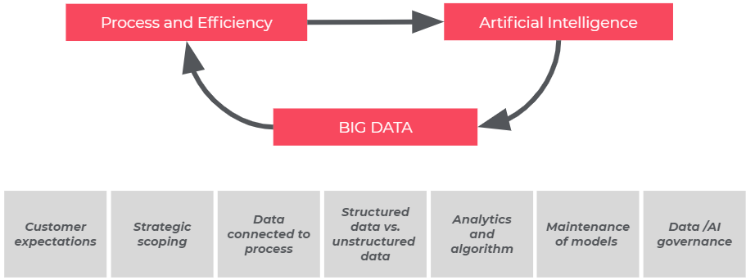
artificial intelligence group strategy.
Machine learning and artificial intelligence to rapidly and repeatedly deliver you insights and advantages from your data.
Different fields of artificial intelligence and not Only Bot
Implement industrialization processes for AI
Propose and develop APIs on the most common use cases at our customers: fraud detection, sentiment analysis, community graph analysis, customer segmentation
AI for AI.
AI for Offers.
Help offer manager/director to inject artificial intelligence into their offers And how artificial intelligence can be beneficial
AI industrialisation.
Notes:
Stratégie de mainteance des modèles en prod

Slide 23
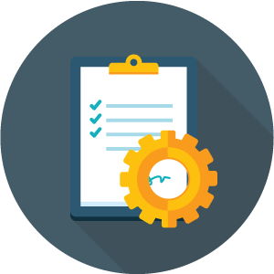

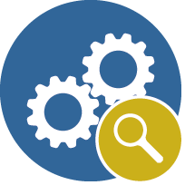
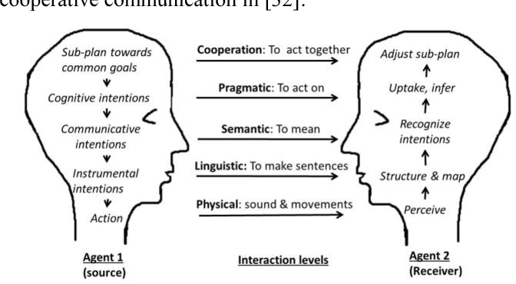
We help our customers, across sectors, to make the most of AI
in 4 intensive domains
Digital Signal Processing
Logic & Reasoning
Bot & Cognitive interaction
Knowledge Management
Signals analysis ( voice, image, video)
discover patterns and draw insights.
Business process intelligence
Optimize business with the strength of data and process mining.
Natural interactions
Cognitive Systems with high level of reasoning and processing
Knowledge Modelling
Knowledge interaction
Knowledge extraction
Notes:
Learned process optimisation
Continuous discover and act on optimisation opportunities and adapt to changed circumstances
To add? Differential privacy
We could add another slide on the different AI techniques that can be used

Slide 24
Our know-how in artificial intelligence
MACHINE LEARNING
_Supervised Learning
_(Partially) unsupervised learning _Sequential & reinforcement learning _Optimisation for learning
_Bayesian methods
_Neural networks _Kernel methods _Deep learning _Data mining _Massive data analysis
_Knowledge bases _Knowledge extraction & cleaning _Inference _Semantic web _Ontologies
NATURAL LANGUAGE PROCESSING
NEUROSCIENCES, COGNITIVE SCIENCES _Understanding & simulation of the brain & of the nervous system
_Cognitive sciences
_Speech
_Vision
Object recognition
Activity recognition
Search in image & video banks 3D and spatiotemporal reconstruction
Objects tracking & movement analysis
Objects localisation
Visual servoing
DECISION SUPPORT
ROBOTICS
_Design
_Perception
_Decision
_Action
_Robot interaction (environment/humans/robots) _Robot fleets
_Robot learning
_Cognition for robotics & systems
ALGORITHMICS OF AI _Logic programming & ASP
_Deduction, proof _SAT theories
_Causal, temporal, uncertain reasoning _Constraint programming
_Heuristic search _Planning and scheduling
Notes:
Retravailler ça en modèle landscape

Slide 25



Making the most of AI - Digital Signal Processing
Deep Learning for Drug Discovery and Cancer Research: Automated Analysis of Vascularization Images
Speech
_Vision
Object recognition
Activity recognition
Search in image & video banks 3D and spatiotemporal reconstruction
Objects tracking & movement analysis
Objects localisation
Visual servoing
Improve the algorithms and data architecture that allow for Near-Real-Time Surveillance of Shipping Traffic across the globe
Extract information about consumption habits of consumers from set of images (refrigerators & dining tables) to replace questionnaires

Slide 26
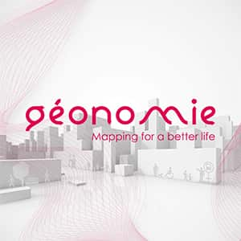

Making the most of AI - Bot & cognitive interactions
design a platform to assess the symptoms of allergy patients and predict the associated risk
Design and Develop cognitive systems to achieve human-level performance at complex tasks, capable of higher-level processing and reasoning
Design a solution based on magnetic geolocation to guide people with reduced mobility in indoor environments
Design a chatbot based service to help back office teams search & explore multiple internal documentation sources

Slide 27
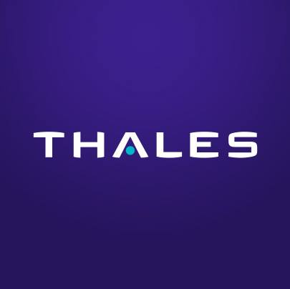


Making the most of AI - Knowledge management
Identify contracts among thousands of documents and process them automatically
Knowledge bases Knowledge extraction & cleaning
Inference
Semantic web Ontologies
Analyze the flow of information within the group to detect new forms of innovation and model new services
Classify documents according to their level of confidentiality and grant access rights

Slide 28
AI by Devoteam.
Marketing Analytics
Price and Promotion & Incentive Strategy
Campaign Effectiveness
Consumer Behavior & Segmentation
Customer Churn and Lifetime Value
Natural Language Processing
Document Extraction, OCR
Text Summarization, Topic Modeling
Chatbots, Recommendation Engines
Call Centers, Audio to Text
Healthcare Analytics
Disease Detection
Population Health & Classification
Electronic Health & Medical Record Analysis
ER and Hospital Optimization
Computer Vision
Image & Video Analysis
Object Detection & Segmentation & Tracking
Medical Images, Manufacturing, GIS, etc.
Noise Removal and Calibration
Manufacturing
Supply Chain & Logistics
Quality Control Automation
Preventative Maintenance
Demand Forecasting & Optimization
Monitoring/Anomaly Detection
Fraud & Fault Detection
Cybersecurity
Event & Risk Analysis
Device & Hardware Usage and Monitoring
Pharmaceuticals
Small Molecule & Compound Analysis
EHR & Clinical Trial Optimization
Real World Data Analysis
Pre-Clinical Automation
Time-Series Analysis
Signal Analysis and IoT
Financial Prediction
Sales Forecasting
Consumer and Devise Behavior

Slide 29
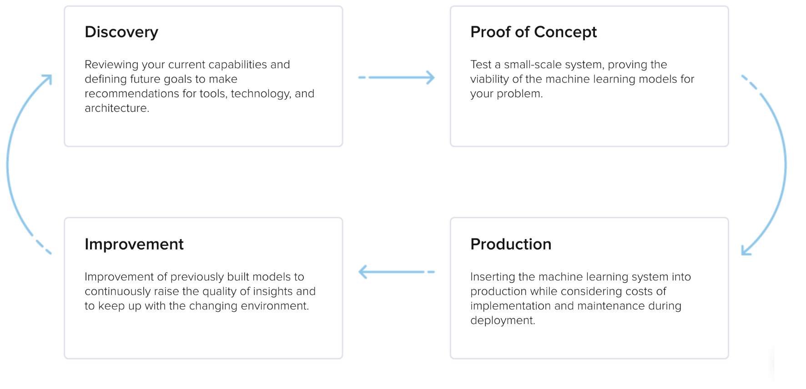
machine learning and artificial intelligence to rapidly and repeatedly deliver you insights and advantages from your data
CRISP - AI
Notes:
Retravailler ::

Slide 30
AI industrialization
Process and Efficiency
Artificial Intelligence
BIG DATA
Customer expectations
Strategic scoping
Data connected to process
Structured data vs. unstructured data
Analytics and algorithm
Maintenance of models
Data /AI governance

Slide 31
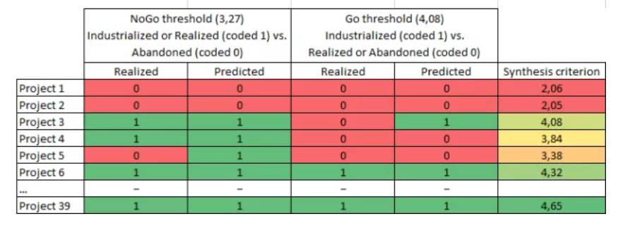
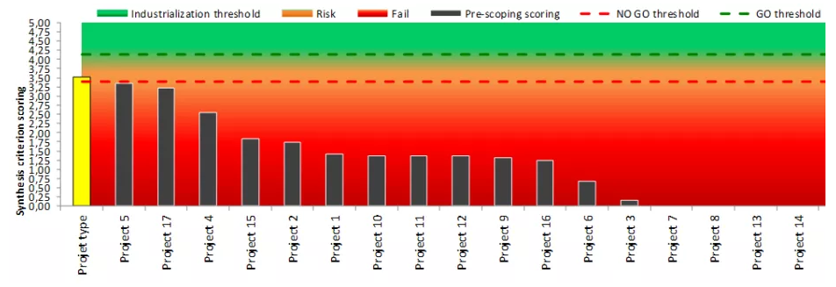
Machine Learning to predict Machine learning

Slide 32
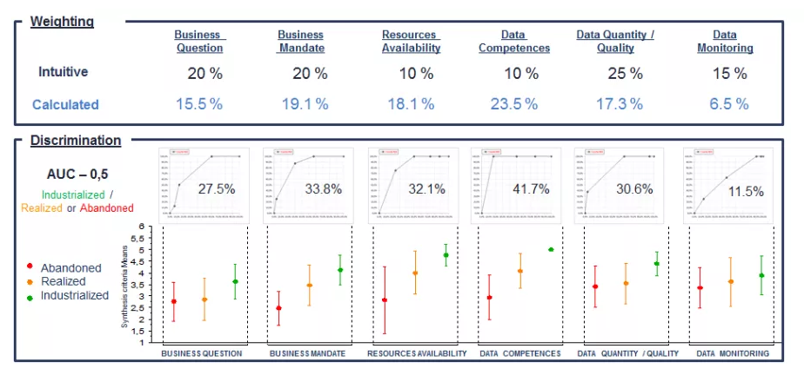
Machine Learning to predict Machine learning

Slide 33
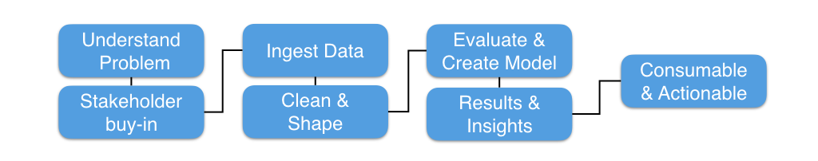
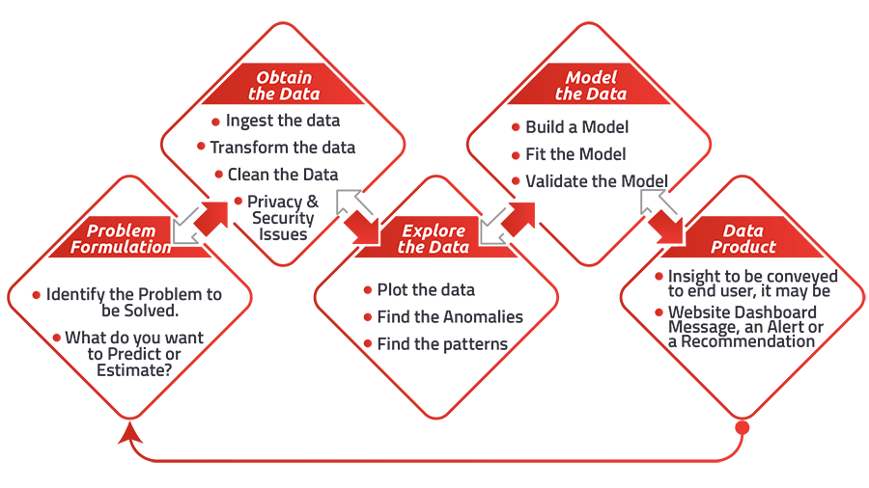
AI Process

Slide 34
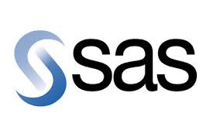
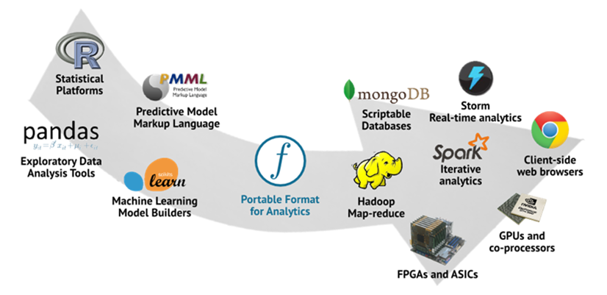
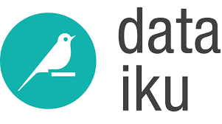

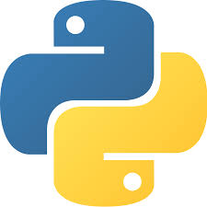


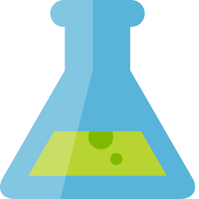
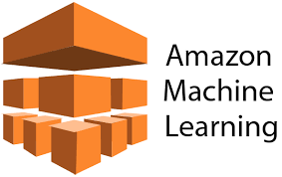
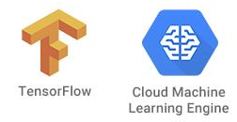
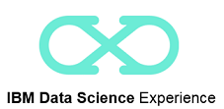
From modeling to production

Slide 35
A platform to support the
end to end AI Workflow.
Connect & Access Data
Search and Find Relevant Data
Prepare Data for Analysis
Build and Train ML/DL Models
Deploy Models
Monitor, Analyze and Manage
Connect and discover content from multiple data sources in the cloud or on premises. Bring structured and unstructured data to one toolkit.
Find data (structured, unstructured) and AI assets (e.g., ML/DL models, notebooks) in the Knowledge Catalog with intelligent search and giving the right access to the right users.
Clean and prepare your data with Data Refinery, a tool to create data preparation pipelines visually.
Use popular open source libraries to prepare unstructured data.
Democratize the creation of ML and DL models. Design your AI models with the most popular open source and ML/DL frameworks or leverage transfer learning on pre-trained models to adapt to your business domain. Train at scale on GPUs and distributed compute
Deploy your models easily anywhere and have them scale automatically for online, batch or streaming use cases
Monitor the performance of the models in production and trigger automatic retraining and redeployment of models. Build Enterprise Trust with Bias Detection, Mitigation Model Robustness and Testing Service Model Security.

Slide 36





They trust us
Data Science & AI Prediction of incidents related to change in control tour
AI & Big data Conception of data services offer - Design of data architecture to support risk management
AI
Design ML-based techniques for card fraud, and for targeted customer offers
AI Speech recognition to secure app-based transactions
AI
Natural Language Platform Processing to review customer chat logs to enhance the quality of customer interactions
AI
Implement Machine Learning in its “AppBank” to automate corporate system management
AI
Machine learning project based on Artificial Neural Networks to identify the authenticity of identity documents
AI & Data management
Using Machine learning to Define MDM and improve data quality

Slide 37

Our AI trends : we are moving towards ...
RPA mixed with AI & RaaS
Lean and augmented data learning
Digital twin
Deep learning theory
Hybrid learning models
Automated machine learning
Capsule Networks
Deep reinforcement learning
Probabilistic programming
Generative adversarial Networks
Explainable artificial intelligence

Slide 38
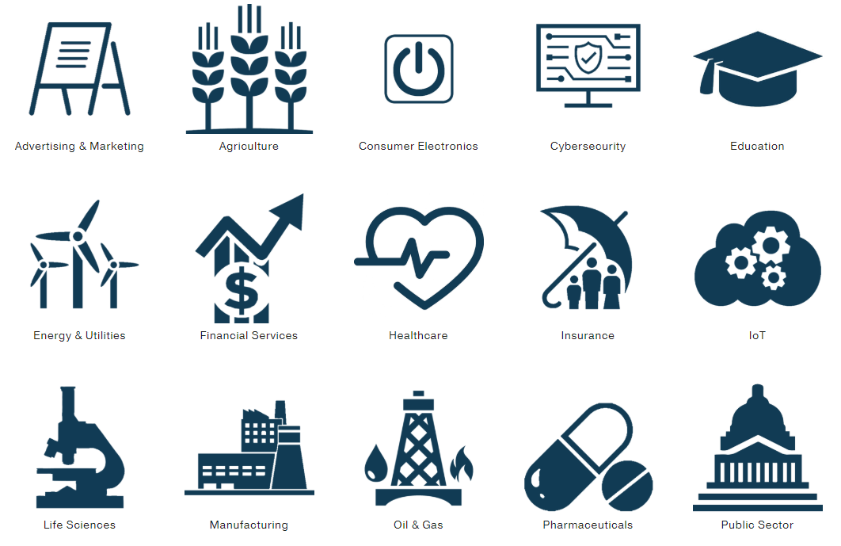
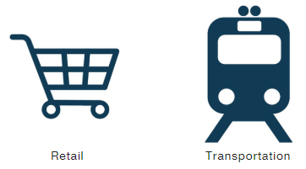
Industries

Slide 39


Retail
CONSUMER ANALYTICS & INSIGHT
Recommendation Engines: Localized, personalized promotions, aggregating data from across platforms and devices into single stream to recommend products in real-time
Analyze Brand Sentiment: Reducing customer attrition, improving cross-sell and bundling of services, increase customer satisfaction
Sales and Performance/Product Optimization: Improving customer acquisition, prevent customer lapse and targeted win back. Use NLP to analyze emails, surveys, and customer communication to identify best service mode and response language.
Segmentation: Leverage data mining and engineering to create meaningful groups and micro-segments at both product and store levels. Develop models to monitor and align store performance, product performance, product attributes, store attributes, and demographic data.
PREDICTIVE ANALYTICS & REVENUE GENERATION
Store Layout and Location: Merchandize and improve same-store revenue using in-store location data. Create models to best bundle and feature product groups for individual stores.
Ad Optimization: Develop models for ad types, placementy location, personalized and location-based ad management, and shopping cart abandonment or next-best-product analytics. Develop tailored offers through online behavioral analysis and web analytics.
Call Center: Optimize performance, service levels, and recommendations through call center analytics, natural language processing, and automated systems.
Supply Chain: Develop advanced supply chain models, to predict product routes, demand, as well as predicting staffing needs, giveaway and in-store promotional success, combination orders and packaging, and cash register data collection for predictive analytics input

Slide 40


The pharmaceutical industry
Common Use Cases
DRUG DEVELOPMENT & DISCOVERY
Model biological systems to predict outcomes and help identify new potential-candidate molecules with a high probability of successful drug development.
Deep Learning: Scrape and model existing and novel datasets for physicochemical properties, formulation or target prediction, and absorption, distribution, metabolism, excretion, and Tox.
Risk: Predictive modeling of risk factors associated with drug reaction and drug-to-drug interactions.
DRUG DEVELOPMENT & DISCOVERY
Patient Selection: Data-based patient selection can create more targeted pools of candidates for clinical trials ensuring the best population for each drug is selected. Target and segment specific populations and candidates, enabling more powerful and less expensive trials.
Real-Time & Mobile Solutions: Real-time patient monitoring can detect anomalies from trials to immediately identify safety risks. Virtual patient coaching for individuals can be used to improve patient outcomes.
Medication Adherence: Engage and guide trial patients with reminders to maintain dosing schedule and compliance with trial parameters to obtain better trial data. Model and use predictive analytics for patient adherence.

Slide 41
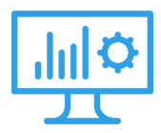

The pharmaceutical industry
Common Use Cases
Risk: Predictive analytics to reduce the risk of drug-drug interactions and adverse patient effects.
Real-Time and Preventative: Track and guide patient dosing behavior to reduce risk when patients do not follow their prescriptions. Model what drives patients to stop taking medications and which patients are likely to 'drop-out'.
Deep Learning & NLP: Scrape literature, review EHRs, and create powerful models for drug repurposing. Use computational tools to sift through sequencing and genomic data to discover novel drug-disease pairs and validate CRO trials.
POST-DEVELOPMENT
Scrape claims data or electronic medical records into more efficient drug development. Increase personalization of therapy and treatment to improve patient relationships. Identify new markets and underserved populations.
Providers & Payors: Aggregate and maintain data stores, combining predictive analytics to analyze patient outcomes, studies, claims, and other real-world data, to investigate beyond clinical trials.
Sentiment Analysis & Targetting: Leverage unstructured data physician information, EMRs/EHRs, media, and payer information to flag potential safety issues and explore new markets. Establish predictive methods ahead of drug releases.
REAL-WORLD DATA & INTEGRATION

Slide 42
FINANCIAL SERVICES
Common Use Cases
Predictive analytics can be applied to a host of unstructured data, combining predictions from sentiment, traditional data sources, and models. Developing models for forecasts, market analysis, and trends, or simulating patterns. Since business cases are client specific, some of our latest work is below
Credit Ratings: Analyzing continuous feeds real-time data for credit ratings providing lenders more accurate snapshots of a customer’s assets, business, operations, and transaction history.
Tracking Tools: Develop tracking tools to mine and report key metrics, new reports, release for target companies, products, segments, and industries. Analyze millions of data points across the market and consumer base to determine the correct investment strategy.
Volume Analysis: We can implement volume examination models to make pricing predictions. Similar models examine social and search traffic, identifying online precursors for stock market moves.
Financial Analysis: We can analyze and create decision platforms for payments, credit providers, and institutional traders, integrating historical and real-time data transactional data to improve efficiency.
REAL-TIME & PREDICTIVE ANALYTICS
We apply natural-language processing, logic, text analysis and summarization to examine media, documents, and external data to discover what folks really think.
Algorithms: Build tools around market sentiment data (e.g., Twitter feeds) for real-time and in-depth trend and news analysis.
Target Tracking: Create algorithms to track trends, monitor the launch of new products, respond to issues, and measure improvements in overall brand perception.
Operations: Analyze unstructured voice recordings from call centers, improve customer service, and optimize churn, up-sell, cross-sell, and products. Filter fraud and prevent unauthorized access.
SENTIMENT ANALYSIS

Slide 43

FINANCIAL SERVICES
Common Use Cases
Detect and prevent fraud (e.g. transactions, credit card fraud, phishing) by leveraging advanced analytics to predict anomalies in real time.
Graph Analysis: Create machine learning security systems to track patterns and assess in real-time threats and fraud. Monitor user profile information, historical data, credit data, and access point information to predict risks and automate action.
Financial Fraud: We can analyze account balances, spending patterns, credit history, employment details, location, and other information to determine if transactions are legitimate and automate their handling.
Credit: Combine segmentation tools with predictive analytics to determine the return on credit and loans. Ingest location, neighborhood development, social, credit reports, business reports, transaction history, demographics, and historical data to make predictions.
Audit: Improve data management and deploy new generation analytics on your existing systems (or employ a cloud strategy) to improve fraud and criminal activity detection. Visualize in real-time, with aggregated risk data, risk models and analysis.
RISK & FRAUD DETECTION

Slide 44



INSURANCE
Deep Learning & AI: Using deep learning, we can help create a quantified understanding of an individual's risk profile and habits, leveraging unstructured data to cut through the noise and get insights faster.
Health and Life Insurance: Leverage medical records, Rx notes, social media, and health apps to aggregate and improve proactive case management. Lower claims by guidance and prevention, with simple things like active dosage monitoring and medication reminders.
Call Center: Combine telecom data and call center activities to refine guidelines, optimize services, and increase customer satisfaction. Use Natural Language Processing (NLP) and speech analytics to improve performance and establish SOPs.
Infrastructure: Deploy cloud-based and open data solutions for data stream management. Test ideas faster by running computational intensive experiments on powerful hardware and lower operational costs by auditing existing hardware and practices.
PREDICTIVE MODELING
Natural language processing or text analytics
Behavioral Analytics
Pattern, graph, or cluster analysis
FRAUD DETECTION
Image Analysis: Automate data labeling, segmentation, and classification of desired objects in an image: Houses, roofs, cars, swimming pools, trees, and vegetation, as well as estimating their condition and quality.
Anomaly Detection: Create alert systems for acute events, such as weather and natural diasters, monitoring movement and disruption.
SATELLITE IMAGING

Slide 45


ADVERTISING & MARKETING
Common Use Cases
Move beyond traditional business intelligence and business monitoring stages with data and analytic investment. Apply analytics to solve customer-centric business problems using data science to understand and quantify behaviors, preferences, patterns, interests, and predict their value.
Common use cases include:
Sales attribution
Reducing customer attrition
Improving cross-sell and bundling of services
Increase customer satisfaction
Improving customer acquisition
Prevent customer lapse and targeted win back
We can help build actionable customer analytic profiles for your use case.
CONSUMER INSIGHT & BUSINESS INTELLIGENCE
Develop monitor and learn systems that pull information about campaign performance across all teams to reveal trends, insights, and customer activity. Optimize campaign spend, testing, and decision-making using machine learning recommendations.
Real-Time Bidding: Develop price optimization, bidding strategies, and optimize ad placement and targets.
Ad Optimization: Develop models for ad types, placement location, personalized ad management, and shopping cart abandonment or next-best-product analytics.
Click & Engagement: Track and monitor click and paths of consumers, optimizing shopping cart and recommendation systems for a personalized consumer experience.
AUTOMATE CAMPAIGNS & GENERATE DECISIONS

Slide 46
ADVERTISING & MARKETING
Common Use Cases
In relation to ad tech, the applications of data science are nearly endless and must be targeted to specific business goals. The fundamental questions here are not changed, however, we now have the tools to build automated systems, that work in real-time to mine and utilize these resources efficiently.
For example, by leveraging big data collection and social information, we can identify not only which ads are being clicked by what households, but how ad placement appeals to which user segments, and should be bundled with what complementary services and products.
We build data science tools and platforms, approaching profitability improvement in broad categories:
Product | Portfolio Assessment
Advertising Pricing | Yield Optimization
Consumer Acquisition | Retention | Yield | Value
Customer Experience | Recommendation Systems
Market | Channel Segmentation & Analytics
Cross and Upsell Analytics
PREDICTIVE ANALYTICS FOR REVENUE GENERATION

Slide 47


INTERNET OF THINGS
Common Use Cases
Safety & Maintenance: Analyze the continuous stream of real-time data at any point in a system's operation (e.g., behavior, environment, mechanical performance, etc.). Our data scientists build algorithms to predict problems, determine best operational practices, and enhance production.
Automation: Automate routine tasks, events, and triggers, removing the need for costly and error-prone manual entry, transcription, sentiment surveys, and similar processes. Create custom solutions that allow your workforce to focus on creative tasks, strategy, and bigger business challenges.
Smart Sensors: Apply IoT infrastructure and predictive algorithms to track key events and information in your business.
Smart Meters: Use readouts to gain high-resolution and up to the minute insights into energy consumption patterns across structures and customer types, while gaining real-time insights into grid operations for forecasting.
Intel® IoT: From modular components to market-ready systems, Intel provides scalable, interoperable solutions that accelerate deployment of intelligent devices, cloud connectivity, and end-to-end analytics.
SENSOR DATA & INDUSTRIAL IOT
Time-series and machine learning methods can be applied to wearables and other interactive electronics to characterize events, movement, and learn a user's behavior.
Fitness: Monitor and predict activity from a variety of sensors and available sources. Whether a new spin on exercise tracking or integrated solutions with voice control, we provide full support and development.
Health: Track vital signs and predict acute health events from common biological signals such as ECG and EEG, or from singular and behavioral events such as falls and breathing patterns. Our work includes algorithms for heart pumps, offloading devices, and safety equipment.
WEARABLES & TRACKERS

Slide 48



INTERNET OF THINGS
Common Use Cases
With increased competition in the home automation space, mass adoption of smart systems and products remains centered around execution and implementation. Let's work together to find the best solution for your product and build a robust technological backbone.
Communication: We develop algorithms for standard and private protocols, providing engineering, time-series analysis, and audio analytics. We develop private integrations and voice activation for popular apps and auxiliary devices such as Amazon Alexa.
Smart Home: We create algorithms for signal monitoring, prescriptive maintenance, and alert systems for home security HVAC, solar, and other device classes.
HOME AUTOMATION
Leverage sensor data to enable smarter supply chain management decisions and to achieve operational efficiency across fleets, warehouse, and employees. We build end to end solutions, incorporating connectivity, cloud services, security, and hardware needs with predictive analytics.
Asset Tracking: Garner granular insight with cloud and predictive analytics to inform and allow real-time monitoring of condition and delivery information.
Fleet Management: Optimize operations by modeling real-time conditions, incorporating traffic, weather, and other information sources. Plot more efficient routes and activity for every situation. Predict and mitigate disruptions and risks to deliver more value to your business.
LOGISTICS
Imaging: With cameras as sensors, AI and deep learning technologies play a key role in a number of emerging areas in shipping, cargo, and distribution. We use the latest NVIDIA GPU accelerated solutions to deploy deep learning algorithms to a range of emerging technologies including drones, robotics, screeners, surveillance, and camera systems.
Cargo & Inventory: Connect smart labels and sensors to monitor cargo integrity and control storage conditions. We build systems with end-to-end visibility into the delivery process.
GLOBAL DISTRIBUTION & SHIPPING

Slide 49


Healthcare
Common Use Cases
We build systems and develop algorithms for automated and computer-assisted analysis of medical images. Recent advances in machine learning, through deep learning and GPU-accelerated computation, have generated both the precision and scale necessary to identify, classify, and predict patterns in medical images of all types.
We specialize in developing technologies for cell detection, tissue segmentation, and feature detection of anatomical tissue in CT, MRI, and high-resolution digital pathology scans. With advanced tools such as anomaly detection, image registration, and 3D-reconstruction, we'll work together to find best practices, implementation, hardware, and data-handling pipeline for your application.
MEDICAL IMAGE ANALYSIS
Migrating systems and devices to modern architecture, such as Hadoop, can transform the operational efficiency while enabling collection of all types of data (structured, unstructured). Further, we can implement near real-time reporting and predictive tools to help organizations store and use information in the best way possible.
Big Data: Population health management, personalized medicine, genomic medicine, clinical trial and decision support databases.
Connectivity: Building the infrastructure necessary for automation and delivery of information to patients, payers, and third-party providers.
Sensor Data: Aggregate and build alert and predictive models for data collected from patient devices, such as wearables and monitors, as well as optimizing the quality of care through the aggregation and analysis of relevant patient history from such devices.
ARCHITECTURE AND INFORMATION MANAGEMENT

Slide 50


Healthcare
Common Use Cases
Leverage data science to garner insights from relevant real-world healthcare data sources, such as electronic medical records (EMR), claims, Rx notes, and drug interaction information to improve outcomes through better treatment patterns and smarter practices.
Natural Langauge Processing: Automate entry, reduce errors, and flag inconsistencies using advanced NLP methods for unstructured and medical data. Predictively determine best treatments and optimize the quality of care through the aggregation and analysis of relevant patient history and care data.
Clinical and Drug Discovery: Optimize methods correlating, modeling, and searching patient records using machine learning to enhance drug discovery and development efforts.
Patient Self-Reporting: Healthcare faces new challenges as individuals explore internet resources and discuss their ailments with peer communities. Leverage the rise of health apps and tele-health to connect providers with patients in the quickest, most personal way possible, in real-time. Aggregate and correlate data sources, audio, text, and streaming data from these interactions to get full patient perspective and maximum value.
ELECTRONIC HEALTH RECORDS
Building more efficient systems means examining all aspects of operations through the most complete data available; we can examine or collect information to solve the toughest business questions and make actionable recommendations with combined domain knowledge. Examples of our work include:
Supply Chain: A strong supply chain management program addresses pricing, standardization, and utilization. We can analyze categories of spending and usage, combining predictive analytics with lifetime value of equipment and reagents to identify and implement supply chain systems that meet or exceed the quality, safety, and cost savings standards of the initiative.
Health Operations: We can model the outcomes, behaviors, and factors of initiatives and programs at each institution or department, finding any pitfalls with data-backed precision. Scheduling, readmittance, and effectiveness and productivity of teams can be monitored.
Payment and Revenue Benchmarking: SFL can extract billing information to determine optimized solutions and methods for process automation and fraud. We can examine claims data, and model reimbursements to predict which payments will be delayed. Further, we can create systems to monitor unreimbursable paired tests that can contradict or are unnecessary.
Patient Care: Assessing whether certain initiatives and programs are translating to health outcomes is critical to value-based care. Further, we can examine prospective cost savings from operational changes.
OPERATIONS & ANALYTICS

Slide 51



CYBERSECURITY
Common Use Cases
Traditional security solutions like SIEM, intrusion, and endpoint security tools, built on known and identified rule sets and signatures, cannot scale to fully meet the demand of advanced cybersecurity operating environments and incoming threats.
We used advanced tools, machine learning, behavior, and predictive modeling to monitor, identify, and secure businesses from the latest attacks.
Emerging Vectors: Leverage data science to build tools and models to identify and predict compromised credential, zero-day, and low & slow attacks. Build active threat maps and predict the next attack.
Scalable Solutions: We build tools that grow as data needs increase, leveraging commodity hardware to keep costs low as data volumes increase.
Lateral Movement: Identify anomalous user-level access. Predict next events and generate immediate security alerts and focused monitoring.
User Behavior Models: Build historical behavioral profiles for each user based on complex features monitored in real-time. Deploy graph models and recommendation systems comparing historical information to real-time behavior.
Contextual Data: Using pen-source tools, combine powerful frameworks and libraries to leverage historical information, time-series data, and contextual data to detect sophisticated attacks
MACHINE LEARNING & AI FOR CYBERSECURITY
As attacks increase in complexity and volume - especially in growing IoT and multi-entry environments - it is difficult for traditional analytical tools and infrastructure to secure information due to data volume, response times, and scalability.
Full Data: Security is a big data problem. For a security solution that detects all changes, we develop tools that explore RAW information, not filtered streams. Identify anomalies in device, employee, contractor, device, and network activity.
Big Data & AI: Deploy machine learning to build powerful solutions using baseline behavior analytics, identifying past and current performance and user activity. Track accounts, systems, points of entry, and on the cloud, in real-time.
Threat detection must be able to identify changing use patterns and execute complex analysis rapidly, in real-time. Controls and response tools for such threats and fraud detection must be automated to drive business value and sustain managed security services and teams.
We help incident response teams effectively monitor, solve, and address security incidents, providing both audits of existing systems and building solutions to close loopholes, predict next points of entry, and proactively respond to incoming threats.
Data privacy, loss, and fraudulent behavior can have untold damage on company operations and reputation, let's build advanced custom solutions to gain the proper insights for proper action.
BIG DATA ANALYTICS
REAL-TIME RESPONSE & AUTOMATION

Slide 52
thank you.
#TechforPeople.

